Slide 1
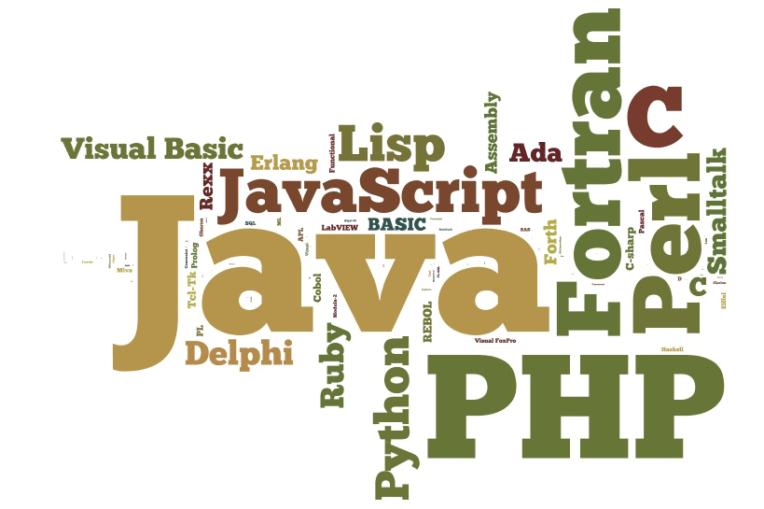
Programming Styles
Wladymir Brborich

Slide 2

What we mean by styles
At least I refer to programming paradigms or approaches to write code
Each has its own set of rules and benefits
You must learn to choose which suits your needs

Slide 3

Why do we have them
It all goes back to solving a problem, in this case Shared State
This code styles where created to try and make our life's easier
Entire programming languages are based on this concepts
It is key to learn what are your options.

Slide 4
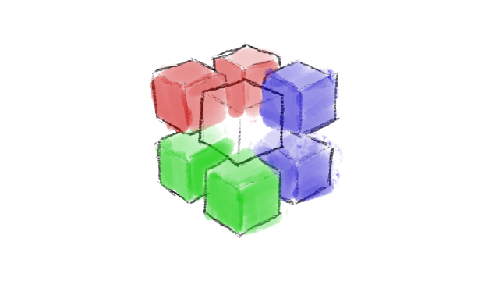
Procedural, Object Oriented, Functional
This are the three main programming paradigms
All of them have their own benefits and problems
They are not mutually exclusive, you can approach your solution by mixing them!

Slide 5
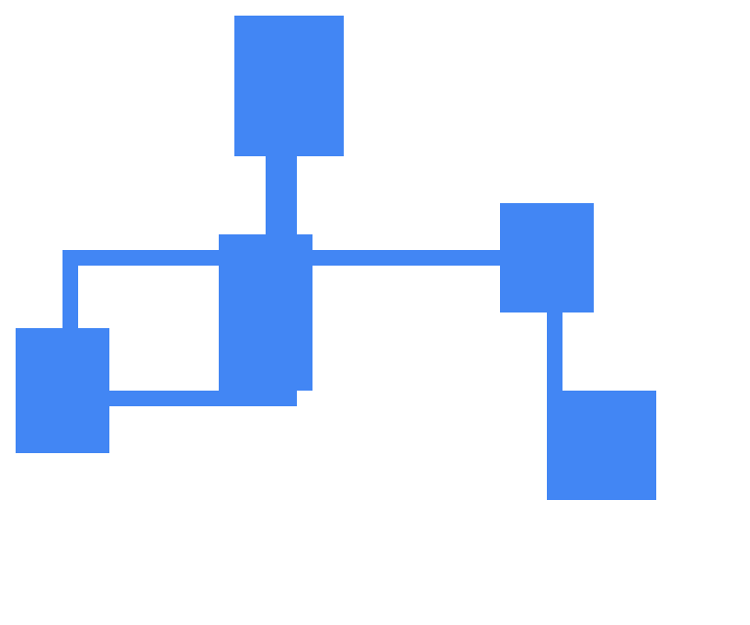
Procedural Code
Procedural yet imperative.
Procedural code often sees the program as a set of procedures or imperative functions, that may or may not alter the state of the execution environment
Blocks of code and scopes

Slide 6

Object Oriented
In contrast to Procedural, OO sees the program as actions that an object performs, each object exposes their behavior through a public interface.

Slide 7

Functional programming
The future of higher level code
Same principles of Procedural languages
The difference relies on the use of pure functions, which not access or modify shared state
Higher order functions instead of looping constructs.

Slide 8

You can mix them
You could have Procedural and Functional code
Object Oriented and Functional
Which complement each other and make your life’s as developers easier

